Slide 1
Individual Meeting
Jason Chang

Slide 2
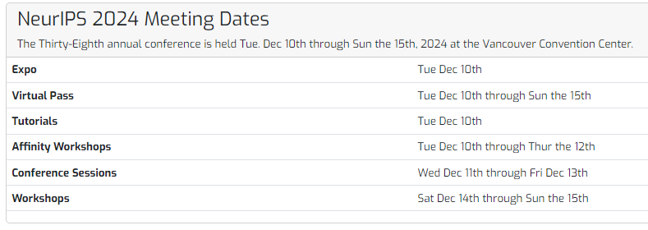
NeurIPS 2024 Date
NeurIPS 2024 Workshop – SSL: 2024/12/14 (Sat.)
One paper
NeurIPS 2024 Workshop – TSALM: 2024/12/15 (Sun.)
Two papers

Slide 3
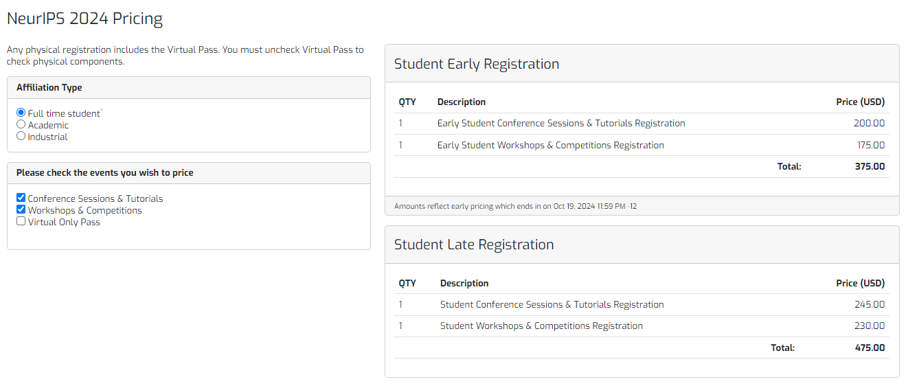
NeurIPS 2024 Pricing
註冊費 (12,079)

Slide 4
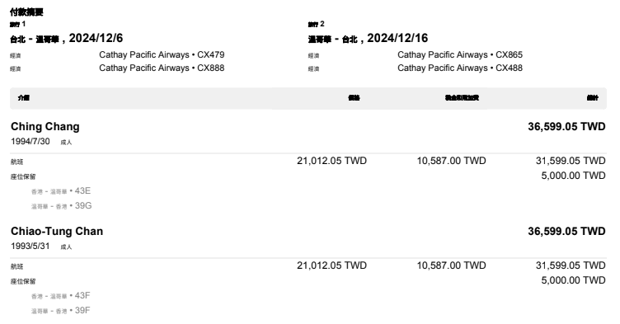
Flights
2024/12/06 (Fri.) ~ 2024/12/16 (Mon.)
機票費 (36,599)

Slide 5
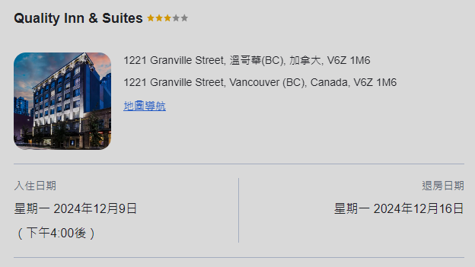
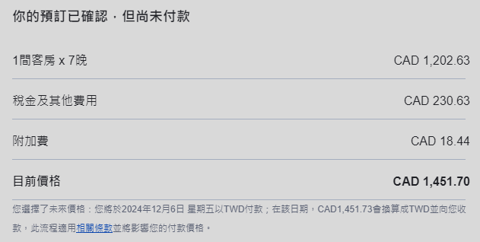

Hotels
我只有放12/9 (Mon.) ~ 12/16 (Mon.)
住宿費 (33,873)

Slide 6
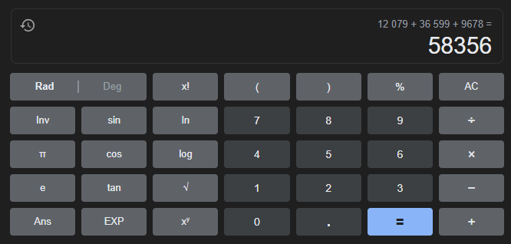
總費用 = 58,356
註冊費 (12,079)
機票 (36,599)
住宿費 (33,873)
住宿費2天 (9,678)

Slide 7
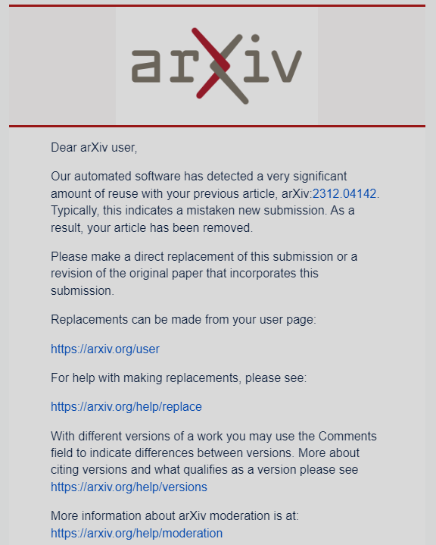
3 workshop papers
TimeDRL
Need to update the text in appendix
LLM4TS
Need to update the text in appendix
Sagar
Text2Freq
Wait for Max

Slide 8
Own Papers
First Author
PromptTSS: AAAI workshop → ICML
JCNet: KDD/CVPR workshop → NeurIPS
Motion/Trajectory Prediction
Collaboration
Text2Freq: NeurIPS workshop → ICML
Esun(?): KDD

Slide 9
Thanks for your attention

